Slide 1
The competition Act, 2002 & Merger
By Dr. Subir Kumar Roy Associate Professor, Department of Law & Registrar (Addl. Charge) Bankura University

Slide 2
Regulation of Combinations Combinations, in terms of the meaning given to them in the Act, include mergers, amalgamations, acquisitions and acquisitions of control.

Slide 3
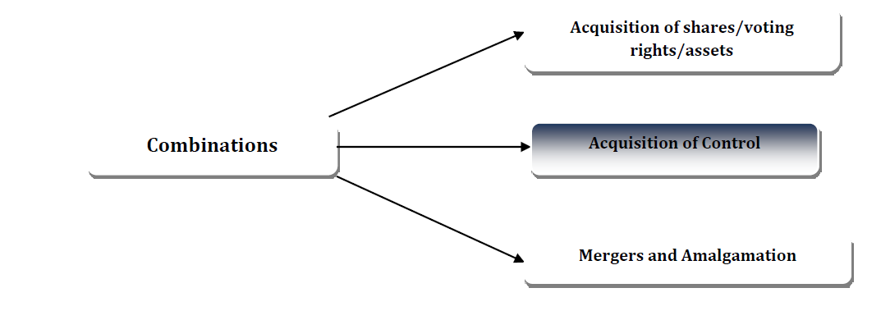

Slide 4
Broadly, combination under the Act means acquisition of control, shares, voting rights or assets, acquisition of control by a person over an enterprise where such person has direct or indirect control over another enterprise engaged in competing businesses, and mergers and amalgamations between or amongst enterprises when the combining parties exceed the thresholds set in the Act. The thresholds are specified in the Act in terms of assets or turnover in India and outside India.

Slide 5
As per Sec.6(1) of the Competition Act, 2002, entering into a combination which causes or is likely to cause an appreciable adverse effect on competition within the relevant market in India is prohibited and such combination will be considered or treated as void.

Slide 6
The current thresholds for the combined assets/turnover of the combining parties
Individual: Either the combined assets of the enterprises are more than 1,500 crore in India or the combined turnover of the enterprise is more than 4,500 crore in India. In case either or both of the enterprises have assets/ turnover outside India also, then the combined assets of the enterprises are more than US$ 750 millions, including at least 750 crore in India, or turnover is more than US$ 2250 millions, including at least 2,250 crore in India.
Group: The group to which the enterprise whose control, shares, assets or voting rights are being acquired would belong after the acquisition or the group to which the enterprise remaining the merger or amalgamation would belong has either assets of more than 6000 crore in India or turnover more than 18000 crore in India. Where the group has presence in India as well as outside India then the group has assets more than US$ 3 billion including at least 750 crore in India or turnover more than US$ 9 billion including at least 2250 crore in India.

Slide 7
The term Group has been explained in the Act. Two enterprises belong to a “Group” if one is in position to exercises at least 26 per cent voting rights or appoint at least 50 per cent of the directors or controls the management or affairs in the other2 . Vide notification S.O. 481 (E) dated 4th March, 2011, the government has exempted “Group” exercising less than fifty per cent of voting rights in other enterprise from the provisions of section 5 of the Act for a period of five years.

Slide 8
In exercise of the powers conferred by clause (a) of section 54 of the Competition Act, 2002 (12 of 2003), the Central Government, in public interest, hereby exempts an enterprise, whose control, shares, voting rights or assets are being acquired has either assets
of the value of not more than 250 crore in India or turnover of not more than 750 crore in India from the provisions of section 5 of the said Act for a period of five years.
(Ministry of Corporate Affairs notification S.0.48 (E) dated 4th March 2011, Source: https://www.cci.gov.in/sites/default/files/advocacy_booklet_document/combination.pdf)

Slide 9
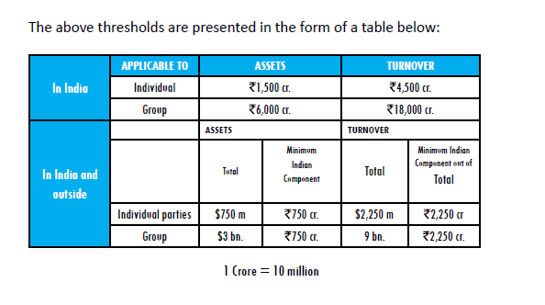
Source: https://www.cci.gov.in/sites/default/files/advocacy_booklet_document/combination.pdf

Slide 10
Here it is pertinent to mention that turnover is assessed on the basis of the values of sales of goods or services. The value of assets is determined on the basis of the book value of the asset shown in the audited books of account of an avocation in a particular financial year but immediately preceding the financial year in which the date of proposed merger falls, as reduced by any depreciation and the value of the assets include the brand value, value of goodwill or IPRs as referred to in explanation (c) to section 5 of the Act.

Slide 11
The review process for combination under the Act dictates mandatory pre-combination notification to the Commission i.e. within 30 days of the approval of the proposal relating to merger or amalgamation by the board of directors or of the execution of any agreement or other document in relation to the acquisition, as the case may be.

Slide 12
The proposed combination cannot take effect prior to the completion of the period of 210 days from the date it notifies the Commission or till the Commission passes an order, whichever is earlier. If the Commission fail to pass an order during the said period of 210 days the combination shall be deemed to have been approved suo moto.

